Slide 1
FTP
By: Gabriel Fok
@gabriel.fok

Slide 2
1. First, the paradigm
Let's start at the beginning

Slide 3
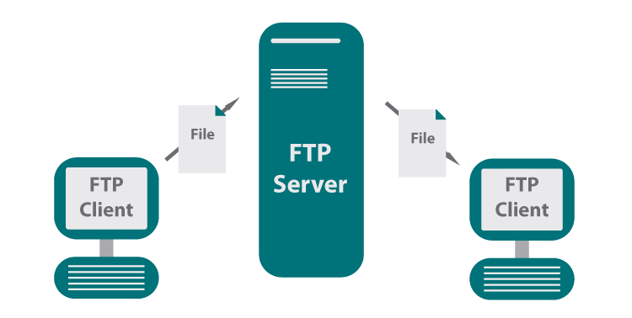
What is FTP?
LITERAL
FTP stands for File Transfer Protocol. It is a protocol for servers used specifically to facilitate the transfer of files. Users can either upload files to the server, or download files from the server.
IMPORTANCE
When you hear FTP you should immediately think “FORCED TO PROTECT.” FTP servers are notoriously known to the be a problem because it allows for users to upload content, which potentially may be things like malware, scripts, etc. if not secured properly. In terms of CyberPatriot, you wouldn't have to worry them actually doing that, but it does hint at what things you should be securing.
More info on https://en.wikipedia.org/wiki/File_Transfer_Protocol

Slide 4
Understanding real world FTP
In a typical business setting, FTP serves a really obvious, but important role. It serves files to those who need it, and stores files for others. It can be used for public and private files alike. The first step to really understanding how to secure FTP is to understand how to use FTP.

Slide 5
Real World FTP
A REAL EXAMPLE
Try accessing ftp.mozilla.org in your web browser (host or VM, doesn't matter).
If you see “Index of /” then you connected properly.
What you see is a file system that is hosting its files for download.
NOTE: Firefox has disabled direct FTP access due to the pandemic, though it does have plans to eventually remove FTP as a feature of Firefox.
BUSINESS BREAKDOWN
This purpose of Mozilla hosting this FTP server is for people to download their product Firefox (a web browser). Notice how this business server didn't require a login?
This is an example of a public (aka anonymous) FTP server. You can tell because you did not have to authenticate yourself to connect.
Some anonymous FTP servers may still display a login, but the credentials are publically known.
e.g. Username: ftp, Password: (none)
e.g. Username: anonymous, Password: anonymous

Slide 6
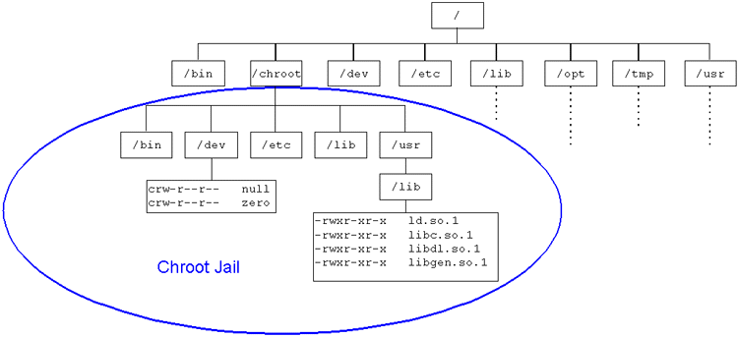
Real World FTP (Security)
Did you notice how the / of the file system was being publicly hosted? Did a $450 million a year company accidentally leak their server's entire computer to whole world for free?
NOPE. This is what's known as chroot jail (pronounced “c h root” or literally “chroot”). This function that Mozilla enabled allows a particular directory (usually not the real /) to function as the / for the FTP server. The “ch” in chroot stands for “change”, hence they CHANGED the / directory. This is not an all-powerful technique, but it does protect against the obvious dangers of file system access.
CHROOT DEEPER:
This graphic shows a specific directory /chroot.
If a user or process or server is chrooted there,
it will use /chroot as /, and should have no visibility
to anything outside.
e.g. /chroot/etc will look like /etc to a chrooted FTP

Slide 7
2. For the practitioners
Time for the nitty-gritty

Slide 8

The World of FTP
The FTP server you just saw is just one example/type of FTP servers. The 3 most likely types of FTP you will encounter are VSFTPD, Pure-FTPD, and Pro-FTPD. Each simply builds upon FTP because by itself, FTP has limited integration/security.

Slide 9
Three of a kind
Pure-FTPD
The least configurable, yet most secure (at least on paper). It has the lowest CVE count of the 3, but it also the least used/focused. It is very simple, but doesn't scale well with lots of users.
VSFTPD
The VS stands for Very Secure, because it was made with security in mind. It is the lightest weight of the three. Due to its popularity, it has more than Pure, but it is very secure nonetheless.
Pro-FTPD
The most configurable, most supported, and oldest of the 3, it is also the least secure. It has many extra modules (like Apache) and works well for high configuration needs.

Slide 10
Pure-FTPD
Setup
Install:
sudo apt-get install pure-ftpd
To start:
systemctl restart pure-ftpd
Add a user ftp that will function as the anonymous user if one wasn’t created when you installed pure-ftpd.
Use
Security

Slide 11
Pure-FTPD
Setup
Things to note:
If you login to a user, the directory you start in will be that user’s home directory.
Anonymous users are naturally chrooted.
If you choose, you can set up Pure-FTPD to use its own “virtual” users entirely separate of UNIX users. We won’t cover it, but know it could be used.
Use
Security

Slide 12
Pure-FTPD
Setup
GUI WAY
To get your IP:
sudo netstat -lnpt | grep pure-ftpd | hostname -I
Or know that you can refer to your own IP as: localhost
In Firefox:
Type in the ftp://<the ip address you just got>
Type in your username and password
If you typed it in right, you should see something like the Mozilla website from earlier.
Use
Security

Slide 13
Pure-FTPD
Setup
TERMINAL WAY
To open ftp:
ftp localhost
Enter in your UNIX username and password
You the FTP commands “get” and “send” to download and upload files respectively.
Use absolute file paths for more precision, though it can use relative paths if you want. Remote file is the location of what you want to get/send the file name as, local file is the file you want to send/save the file name as.
Use
Security

Slide 14
Pure-FTPD
Setup
Pure-FTPD uses a distributed configuration file. Basically each file is named after the config it represents. Pure-FTPD summarizes the conf directory and uses it as a config file. The directory is /etc/pure-ftpd/conf.
There are a couple configs to know:
TLS: degree of SSL enforcement (0-2)
NoAnonymous: force private
AnonymousOnly: force public
UnixAuthentication: unencrypted authentication
PamAuthentication: use PAM, uses /etc/pam.d/pure-ftpd
ChrootEveryone: chroot everyone to their homes
Use
Security
Notes:
so what should UnixAuth be set to? It should be no
so what should PamAuth be set to? yes

Slide 15
Pure-FTPD
Setup
The difference between AnonymousOnly and NoAnonymous is that you can have a separate “Anonymous” branch of your FTP server that is different from your private one.That’s why you can set both to “no” and it will make sense. Setting both to “yes” is possible, but like… why tho? It will assume anonymous.
If NoAnonymous is set to no, and AnonymousOnly is set to no, it still will not prompt you. Don’t forget to restart the service to push your changes. To login type ftp://<username>@<your ip>.
Use
Security

Slide 16
Pure-FTPD
Setup
TLS:
0 - No TLS/SSL sessions supported
1 - TLS/SSL sessions allowed
2 - Force TLS/SSL sessions
To create self-signed certifications:
sudo mkdir /etc/ssl/private
sudo openssl req -x509 -nodes -days 7300 -newkey rsa:2048 -keyout /etc/ssl/private/pure-ftpd.pem -out /etc/ssl/private/pure-ftpd.pem
Above command to copy: https://pastebin.com/T2aStWdi
Follow the prompts as much as you want to (I usually only do the first 2)
Set the pure-ftpd.pem file you just made to perms to 600
Use
Security

Slide 17
Pure-FTPD
Setup
BrokenClientsCompatibility
MaxClientsNumber
MaxClientsPerIP
VerboseLog
DisplayDotFiles
NoChmod
DontResolve
MaxIdleTime
LimitRecursion
AntiWarez
AnonymousCanCreateDirs
MaxLoad
AllowUserFXP
AllowAnonymousFXP
AutoRename
AnonymousCantUpload
NoChmod
MaxDiskUsage
CustomerProof
Use
Security
Notes:
other confs to look into

Slide 18
VSFTPD
Setup
Install:
sudo apt-get install vsftpd
To start:
sudo systemctl restart vsftpd
Use
Security

Slide 19
VSFTPD
Setup
Literally the exact same as Pure-FTPD (duh, FTP does the legwork) .
Use
Security

Slide 20
VSFTPD
Setup
The real differences are in the security and format. The config file /etc/vsftpd.conf specifies the format to be EXACTLY option=value, with NO additional spacing.
anonymous_enable: public/private
chroot_local_user: chroot local users
local_enable: allow local users to connect
write_enable: allow users to “write” which means make changes to directories
ssl_enable: allow TLS/SSL sessions
Use
Security

Slide 21
VSFTPD
Setup
We assume you remember the previous from Basic Linux. We’ve never encountered SSL vsftpd, but just in case:
openssl req -x509 -nodes -days 365 -newkey rsa:2048 -keyout /etc/ssl/private/vsftpd.key -out /etc/ssl/certs/vsftpd.crt
https://pastebin.com/jd7cq3wg
Set all of these:
Use
ssl_enable=YES
allow_anon_ssl=NO
force_local_data_ssl=YES
force_local_logins_ssl=YES
ssl_tlsv1=NO
ssl_tlsv1_1=NO
ssl_tlsv1_2=YES
ssl_sslv2=NO
ssl_sslv3=NO
rsa_cert_file=/etc/ssl/certs/vsftpd.crt
rsa_private_key_file=/etc/ssl/private/vsftpd.key
require_ssl_reuse=YES
ssl_ciphers=HIGH
Security
Notes:
tls is the successor of ssl, so since we can separate their functions, we will use just tls

Slide 22
VSFTPD
Setup
Chroot List (if only specific users are chrooted):
chroot_list_enable=YES
chroot_list_file=/etc/vsftpd.chroot_list
secure_chroot_dir=/set/a/secure/chroot/dir
Use
Security
Notes:
may need to make the list file

Slide 23
VSFTPD
Setup
Anonymous server configs:
anon_root: where the anonymous user’s home is
no_anon_password=YES
allow_writeable_chroot: may be necessary for error 500
anon_upload_enable
anon_mkdir_write_enable
NOTE: You may have to set the directory permissions to 555
Use
Security
Notes:
may need to make the list file

Slide 24
Pro-FTPD
Setup
Install:
sudo apt-get install proftpd
We will choose standalone when it prompts you.
To start:
You should know by now. Take a wild guess.
Use
Security

Slide 25
Pro-FTPD
Setup
Still the same
Use
Security

Slide 26
Pro-FTPD
Setup
The general config file is /etc/proftpd/proftpd.conf
DefaultRoot : basically chroot to their home dirs
RequireValidShell: enable logging in for users
AuthOrder: use local passwords
You can set up TLS and Self-Signed certs very similarly to Pure-FTPD, just swap in pro-ftpd’s name in.
Don’t forget to check /etc/proftpd/conf.d/ for any conflicting configurations, similar to /etc/sudoers.d/
Use
Security
Notes:
default root on, requirevalidshell on, authorder on

Slide 27
Pro-FTPD
Setup
You can set up TLS and Self-Signed certs very similarly to Pure-FTPD. The .pem file can be made the same way, just swap in pro-ftpd’s name in. To enable, use these configs in /etc/proftpd/tls.conf:
TLSEngine on
TLSLog /var/log/proftpd/tls.log
TLSProtocol TLSv1.2
TLSRSACertificateFile /etc/ssl/private/proftpdCertificate.pem
TLSRSACertificateKeyFile /etc/ssl/private/proftpdServerkey.pem
TLSRequired on
Use
Security
Notes:
default root on, requirevalidshell on, authorder on

Slide 28
Pro-FTPD
Setup
If you want an anonymous ProFTPD server, at the bottom of the config file is a commented block that controls anonymous connections. The easiest way to enable anonymous users is to simply uncomment the block.
Use
Security
Notes:
default root on, requirevalidshell on, authorder on

Slide 29
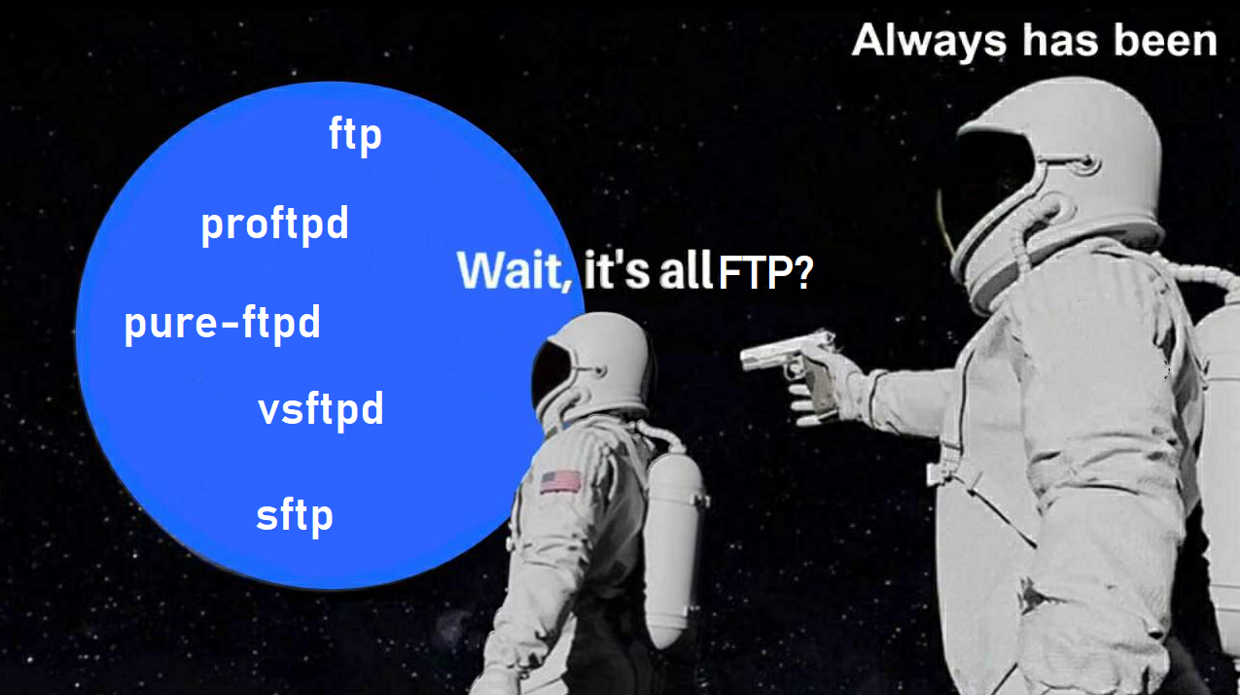
3. Finally, thought permeation
Catch the pattern yet?
Questions?
Instagram: @gabriel.fok

